Slide 1

Operating Systems
Group – 4
3rd Year
CSE – E Section

Slide 2


Crew Of the Project
Tankala Yuvaraj
Roll No: AP19110010221
K. Subrahmanyam
Roll No: AP19110010171
Boyapati Sai Venkat
Roll No: AP19110010174
Avvari Likhitha
Roll No: AP19110010171
D. Nithya
Roll No: AP19110010150

Slide 3

Question
Develop/Simulate a preemptive scheduling algorithm

Slide 4

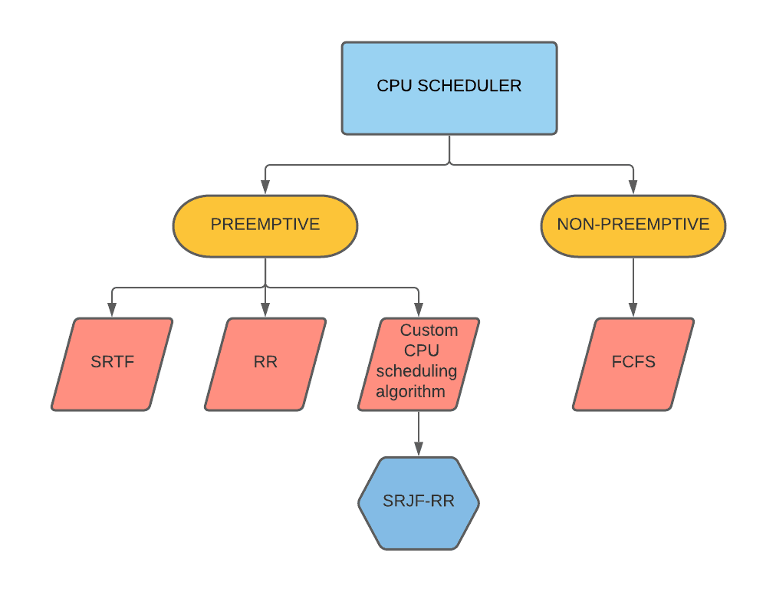
Concepts Used

Slide 5

Solution Part
Solution
Lets Get Into

Slide 6
Hope You Like It
→By Group - 4
Notes:
https://unsplash.com/photos/B6yDtYs2IgY

Slide 7

Notes:
© Copyright Showeet.com – Free PowerPoint Templates

